Slide 1
Warn Your Neighbor About the Dangers of Methane
Catherine Thomasson, MD
Zonta-District 8
March 5, 2026

Slide 2
Intros in chat
Please share in the chat:
Your name
Pronouns (if comfortable)
Where you are zooming from
What is your favorite Climate Action
*If you have questions during the presentations, please hold on to them for our Q & A time in the middle and at the end.

Slide 3
Agenda
Intros
Methane is Bad for your HEALTH
Methane is Bad for your WALLET
Methane is Bad for the CLIMATE
What are the Solutions?
Take Action

Slide 4

Just because methane is called “natural” gas, doesn’t mean it’s safe.
Notes:
BVC

Slide 5
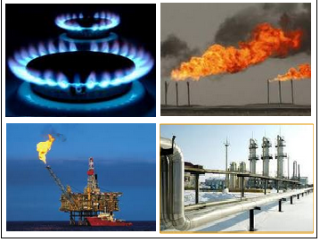
What is “Natural” Gas?
Flammable, fossil gas
Primarily methane (CH4)
5% other hazardous chemicals like benzene and impurities from fracking (radon, other radioactive elements, solvents).
Notes:
What is “Natural Gas”?
Natural gas is a combination of hydrocarbon gas that is primarily methane. It is formed when layers of buried plants, gases, and animals are exposed to intense heat and pressure over thousands of years. It is found in pockets, or intermixed with coal or petroleum products. Before natural gas can be used as a fuel, it must be processed to remove impurities, including water, to meet the specifications of marketable natural gas. The by-products of this processing include ethane, propane, butanes, pentanes and other higher molecular weight hydrocarbons some of which are carcinogenic, cause respiratory problems and combine with the NOx to make ozone. Also hydrogen sulfide (in small amounts compared to coal) may be converted into pure sulfur in processing. Processing of natural gas also removes carbon dioxide, water and other elements.
This picture shows “flaring of natural gases” at on and offshore oil producing sites to prevent the noxious gas from lingering at ground level. Obviously this is loss of a valuable resource but is felt to be less harmful than just allowing it to escape as it is burned into CO2 rather than the more climate forcing methane..

Slide 6
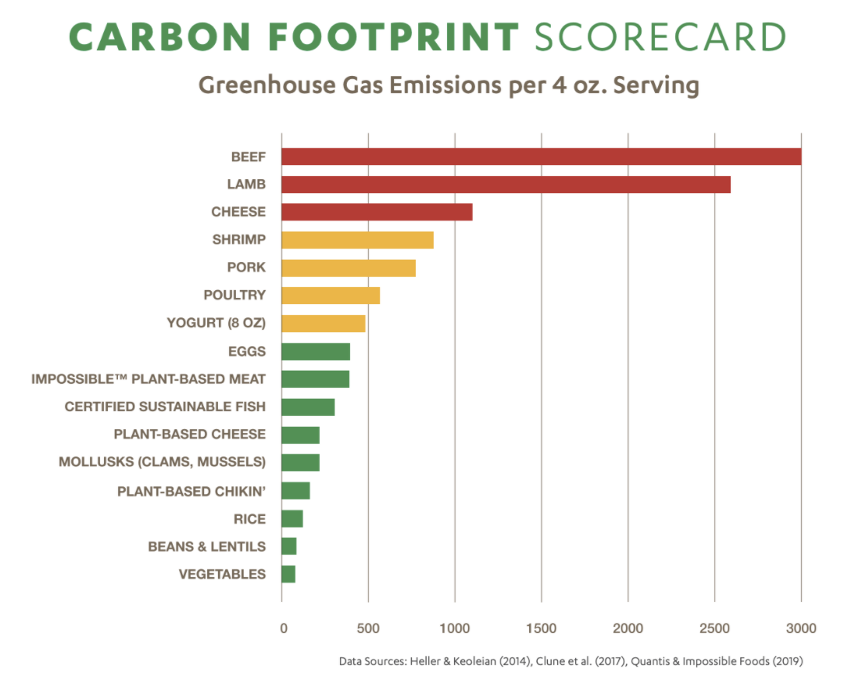

Other Methane Production
Notes:
EU cattle emitting methane are greater source of carbon than their cars.

Slide 7
Methane is Bad for your HEALTH
Health Impacts of Methane Gas
Everything we burn we breathe

Slide 8
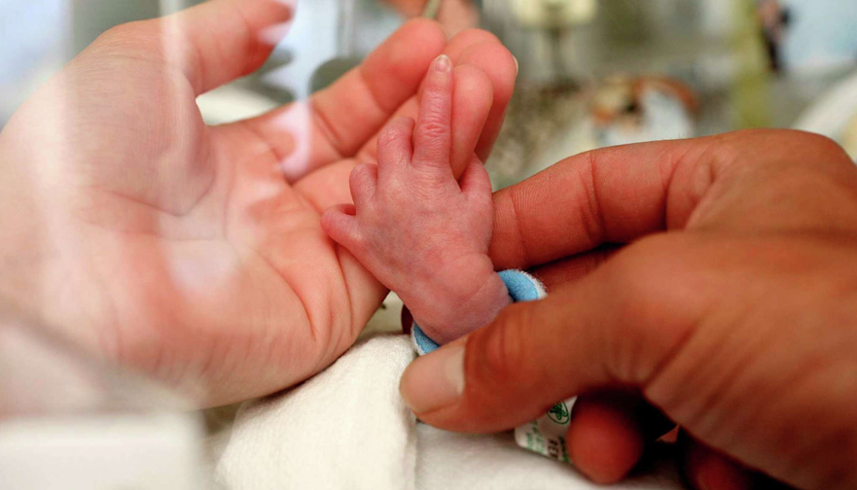
Five Places Methane Gas Impacts our Health
1. Indoor pollution
2. Outdoor pollution
3. Explosion risks
4. Pollution from fracking
5. Climate change

Slide 9
Pollutants Due to Burning Methane are the same as burning gasoline.
Particulate Matter (PM)
Inhaled microscopic particles, such as dust, soot, and smoke. Gets deep
into lungs, heart, brain and placentas. Increases heart attack, stroke, lung diseases.
Carbon Monoxide (CO)
A colorless, odorless gas from incomplete combustion of fuels that can
interfere with the blood's oxygen-carrying capacity.
Nitrogen Dioxide (NO₂) one of the nitrous oxides (NOx)
A gas created by burning fuels at high temperatures. Leads to ozone
when combined with sunlight. Associated with asthma, premature death and more.

Slide 10
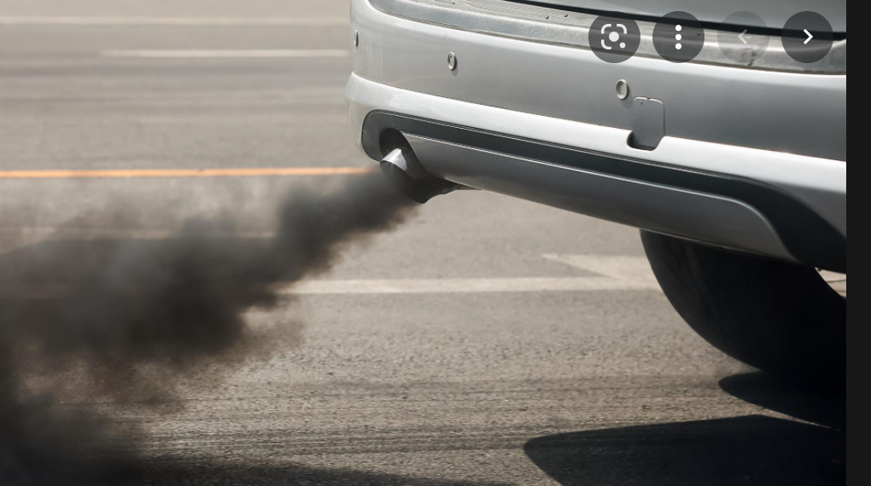
Car Exhaust
Particulate Matter (PM2.5)
Carbon Monoxide (CO)
Nitrogen Dioxide (NO2)

Slide 11
NO2 Also Increases
All-cause mortality, especially with underlying conditions
Lung and breast cancer
Adverse pregnancy outcomes
Exacerbation of chronic lung conditions
Cognitive and learning deficits.
  Air pollution has been associated with increased Alzheimer’s, teenage depression and bad calls by umpires.
Source: U.S. EPA. Integrated Science Assessment (ISA) for Oxides of Nitrogen – Health Criteria (Final Report, Jan 2016). U.S. Environmental Protection Agency, Washington, DC, EPA/600/R-15/068, 2016
Source:

Slide 12
Nitrogen dioxide (NO2)
The outdoor standard for NO2 is 100 PPB for an hour.
There is no indoor standard for NO2, despite the fact that we spend 90% of our time indoors.
Gas stoves emit levels of NO2 that would be illegal outdoors.
NO2 levels are 50% to 400% higher in homes that cook with gas.
Recent study from Stanford looked at the combined NO2 exposure indoors and outdoors in 17 cities. They found that one can cut this exposure by 25-50% just by switching to electric cooking.

Slide 13
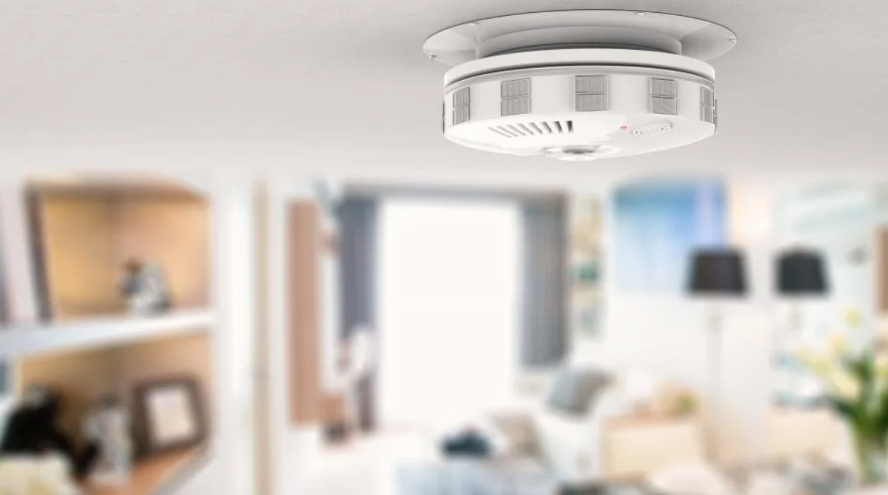
Carbon monoxide(CO)
CO displaces Oxygen
1,244 people died in US (2022) from CO poisoning
Heart and brain affected first
Chronic low levels not triggering CO alarms are also harmful: HA, drowsiness

Slide 14
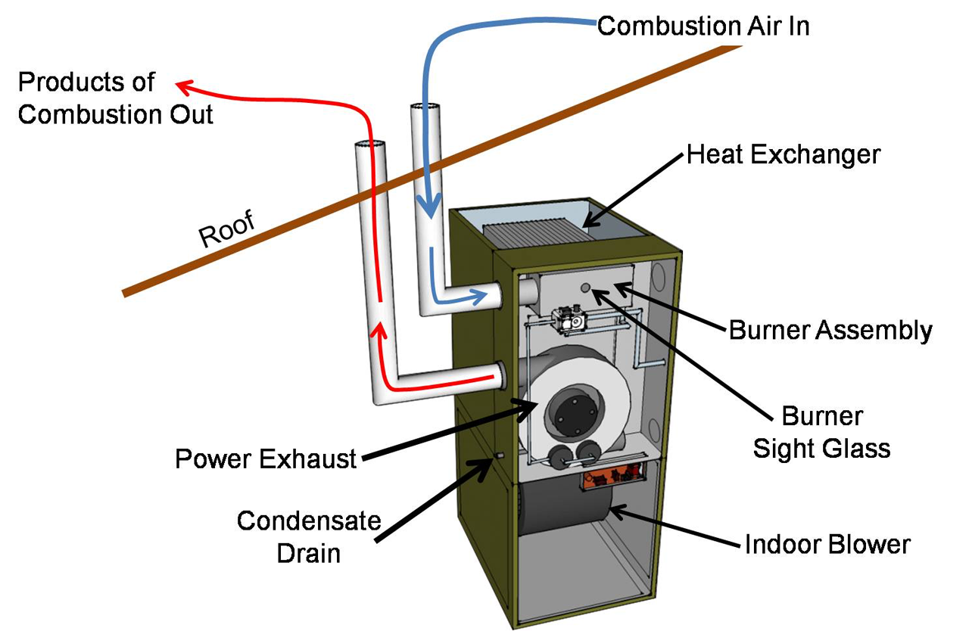
Indoor air Pollution
Did you ever wonder why you must vent your gas furnace but not your gas stove?
Notes:
Did you ever wonder why you must vent your gas furnace but not your gas stove?

Slide 15
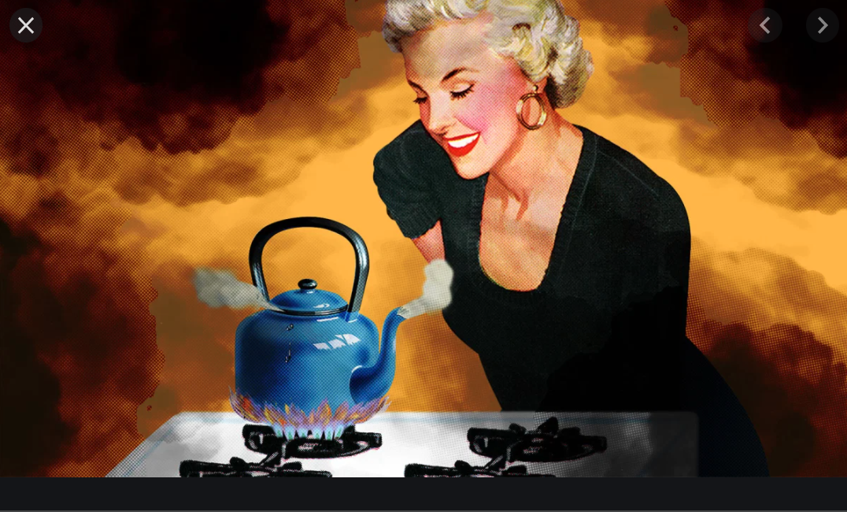
Cooking with Methane Gas

Slide 16
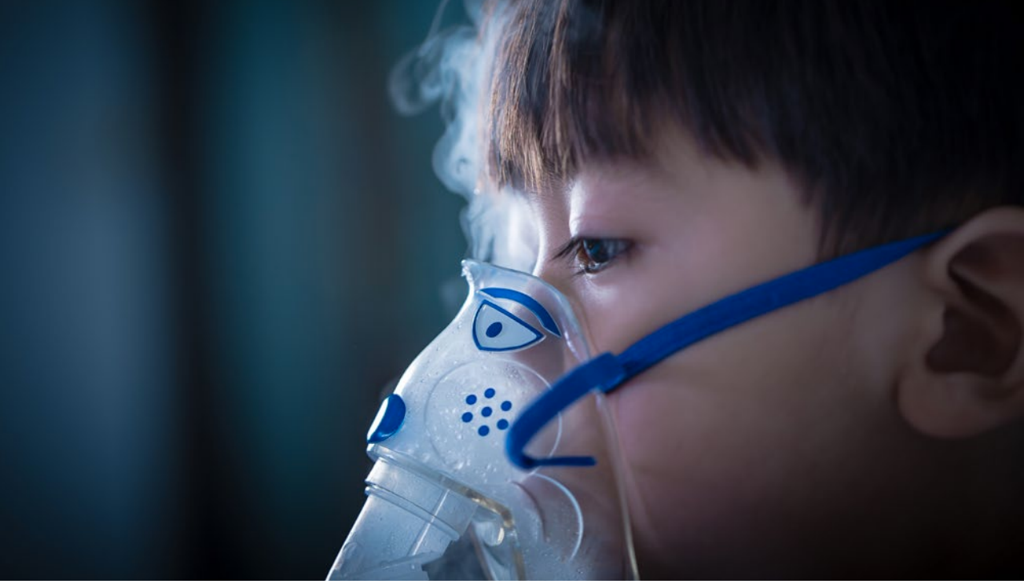
Childhood Asthma and Gas stoves
Asthma is the number one chronic disease in children.
Meta-analysis: 42% increase in the risk of asthma symptoms in children living in homes with gas stoves
24% increased risk for lifetime asthma.
Source: https://doi.org/10.1093/ije/dyt150

Slide 17
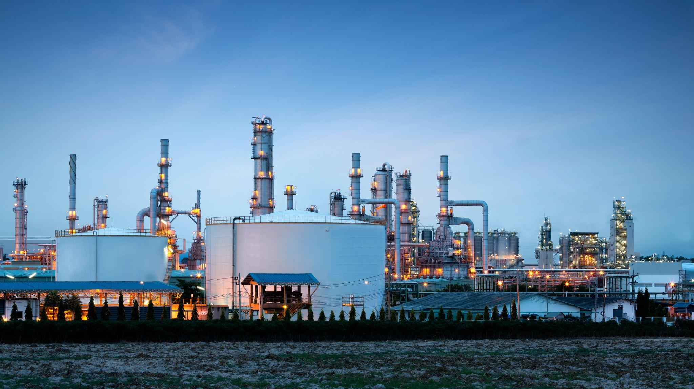
Local Air Pollution and Climate Pollution
Burning fossil fuels in Oregon’s homes and businesses releases more than 4,000 tons of harmful NOx emissions each year — as much as the state’s power generation and cement manufacturing combined.
Fossil fuel equipment in Oregon homes and businesses releases as much climate pollution as 1.1 million passenger cars.
Burning methane in buildings increases both local air pollution and climate pollution

Slide 18
NO2 & childhood health
California – longitudinal study over 20 years
Outdoor NO2 dropped with increased pollution controls on cars.
Childhood asthma rates dropped in tandem with the lower levels.
Kids are affected more by NO2: They have higher respiratory rates, greater levels of physical activity and more lung surface compared to their body weight
Source: Garcia E, Berhane KT, Islam T, et al. Association of Changes in Air Quality With Incident Asthma in Children in California, 1993-2014. JAMA. 2019;321(19):1906–1915. doi:10.1001/jama.2019.5357
Source: Belanger, Kathleen et al. “Household levels of nitrogen dioxide and pediatric asthma severity.” Epidemiology (Cambridge, Mass.) vol. 24,2 (2013): 320-30. doi:10.1097/EDE.0b013e318280e2ac

Slide 19
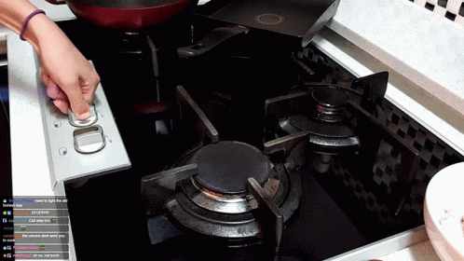
Gas stoves leak methane even when turned off
75% of the leakage occurs when the stove is off
Methane itself may not harm your health, but it is contaminated by a number of substance known to cause cancer, like benzene.
Source: https://pubs.acs.org/doi/10.1021/acs.est.2c09289

Slide 20
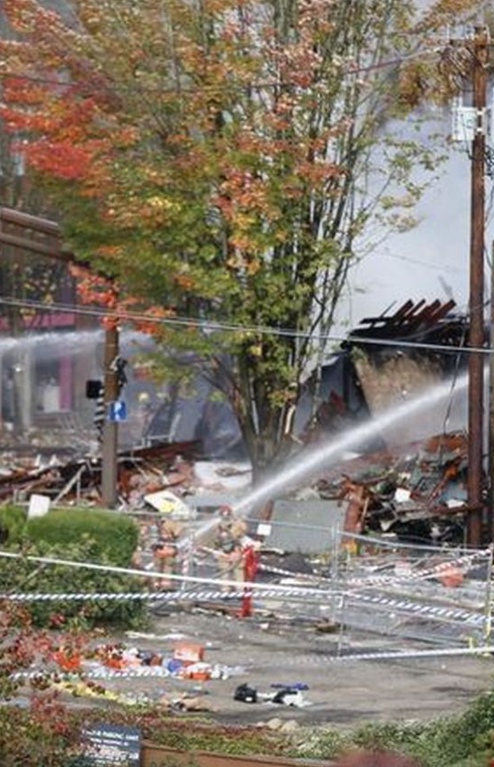

Explosion Risk & Leaks
2016: 23rd Avenue in Portland – injured 8 people, $17 million damages.
Last year: Hollywood theater had to be evacuated.

Slide 21
We all want clean and safe homes
If you are still cooking and heating with methane gas:
Always use your fan hood & cook on back burner
Buy an inexpensive hot plate induction burner ($115-170 e.g. Duxtop 9600)
Tune up your gas furnace to burn cleaner
Replace your gas stove

Slide 22
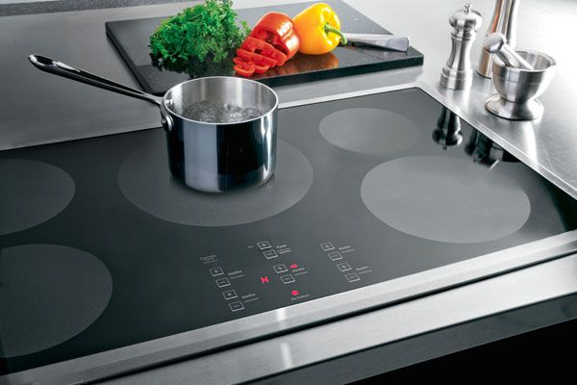

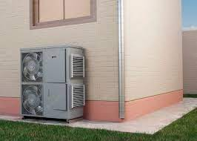
Switching to modern electric appliances –
improves your family’s health, comfort, and safety.
Heat Pump
Induction stove
Notes:
Your home may have a gas stove, water heater, furnace or clothes dryer. The efficiency and safety of all of these improve if you switch to modern electric appliances along with lower costs for those services.
Although in many instances gas appliances are installed by default, appliances like electric heat pumps, were they to become standard, would provide Oregonians both efficient heating and also air conditioning. It’s a two-fer. Air quality improves as well because most heat pumps have improved filtration systems and the by-products of natural gas combustion are eliminated from your home.

Slide 23

Things we used to think were OK ….
Cigarettes
DDT
Asbestos
Lead paint
Gas stoves

Slide 24
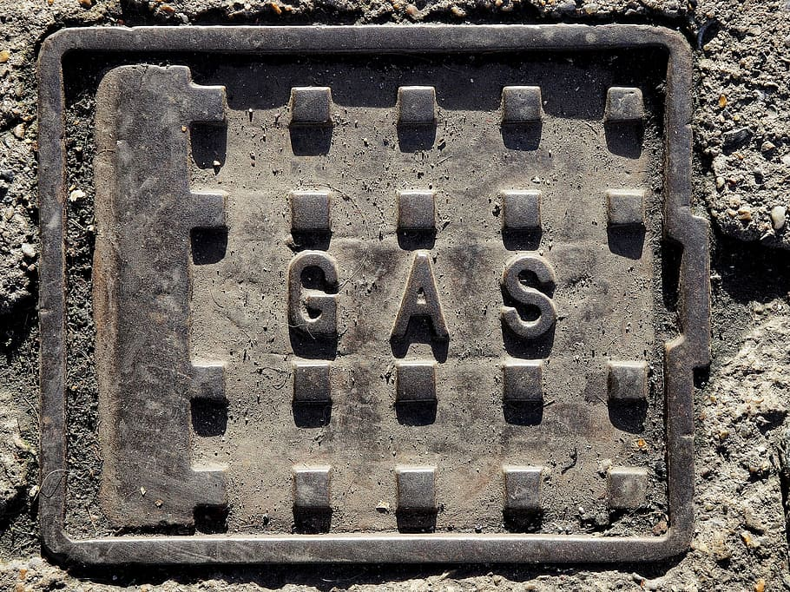

Be wary of the gas companies’ advertising.
Our views on natural gas (methane) have been manufactured by the industry’s PR campaign
Notes:
For many years, advertising from Exxon, Chevron and British Petroleum (BP) have been telling us of their work towards a greener world, while nothing changes. Recently local NW Natural gas ads have been making similar claims. It’s the same approach the tobacco industry used — remember “lite” cigarettes? These ads are designed to make us complacent — to convince us that things will get better if we trust business as usual. (over 70% of people feel “natural” methane gas is safe.
In spite of their suggestions of being “green,” Oregon’s natural gas companies are suing the State to overturn pollution regulations that are tackling climate change and cleaning up our air. And last year NW Natural petitioned the Oregon Public Utility Commission for customer rate increases totaling 42% over a little more than a year to pay for executive pay raises, new methane hookups and to subsidize their misleading ad campaign – “Less We Can.”

Slide 25
Questions?

Slide 26
Decreasing outdoor air pollution from gas appliances saves lives and money
California: if all residential appliances were transitioned from gas to electric:
There would be 354 fewer deaths per year
It would save $3.5 million in health costs per year
Source: https://coeh.ph.ucla.edu/wp-content/uploads/2023/01/Effects-of-Residential-Gas-Appliances-on-Indoor-and-Outdoor-Air-Quality-and-Public-Health-in-California.pdf

Slide 27
Pollutants Produced by Stoves and Ovens
Electric
Particulate matter (PM 2.5)
Gas
Particulate matter (PM 2.5) - twice as much
Carbon monoxide (CO)
Nitrogen dioxide (NO2)
Formaldehyde
Benzene and other carcinogens in unburned gas (leaks)

Slide 28
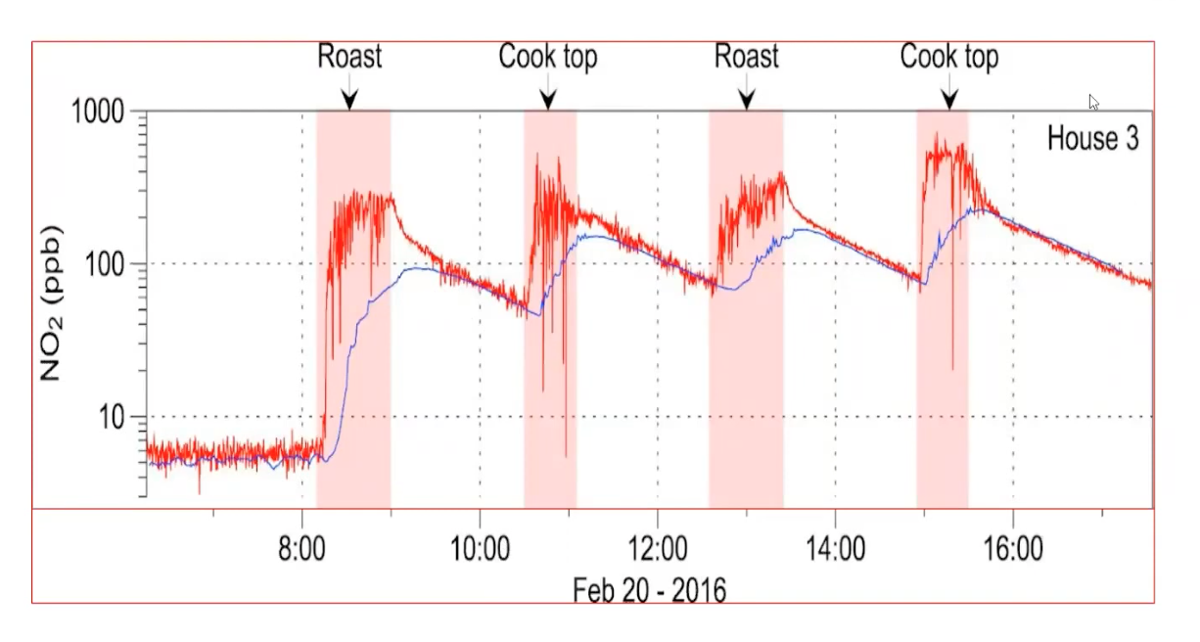
Nitrogen dioxide reaches levels in the bedroom (blue line) which would be illegal outdoors
Source: https://newscenter.lbl.gov/2013/07/23/kitchens-can-produce-hazardous-levels-of-indoor-pollutants/

Slide 29
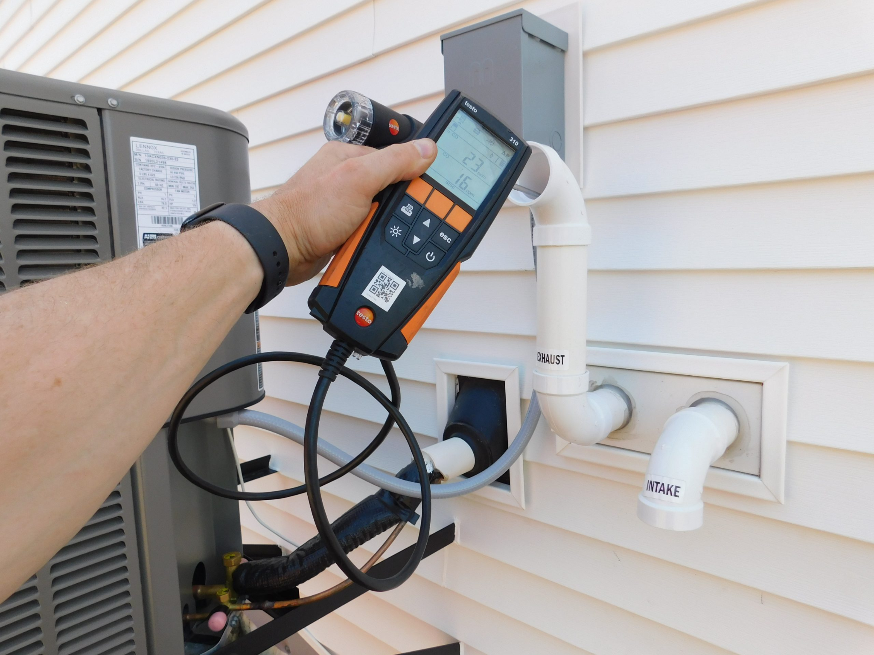
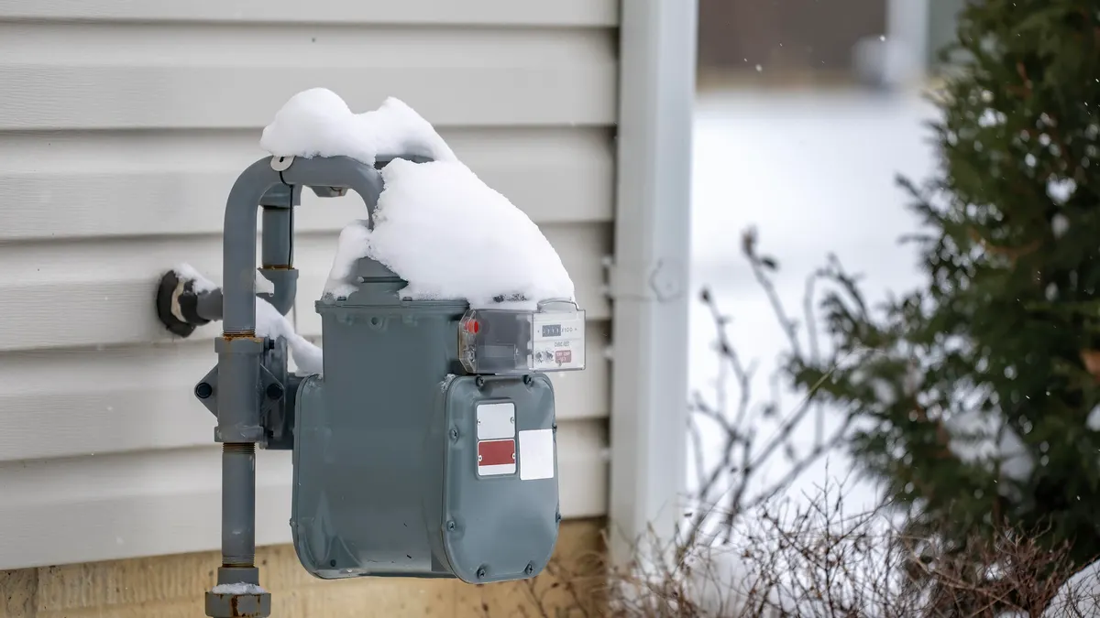
Reliability Myth: Gas in Outages
Utilities often market gas a backup during power outages
But many modern gas furnaces, water heaters, and stoves still need electricity for ignition, fans, controls
Outages are often caused by climate disasters (heat waves, Ice storms, wildfires)
Depending on gas keeps us locked into the same system that’s driving the crises causing the outages

Slide 30
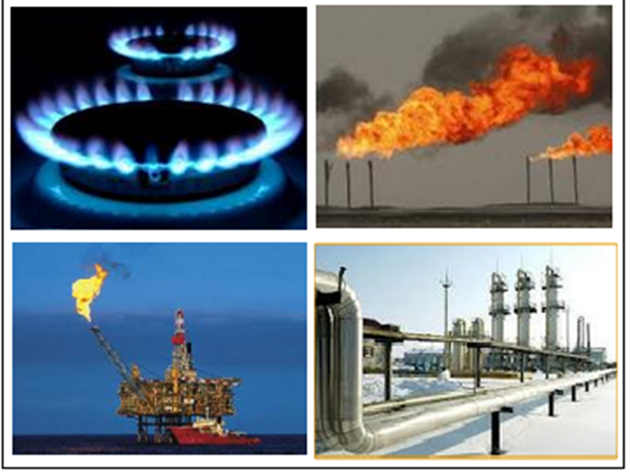
Methane is Bad for
our Wallets.
Notes:
BVC

Slide 31
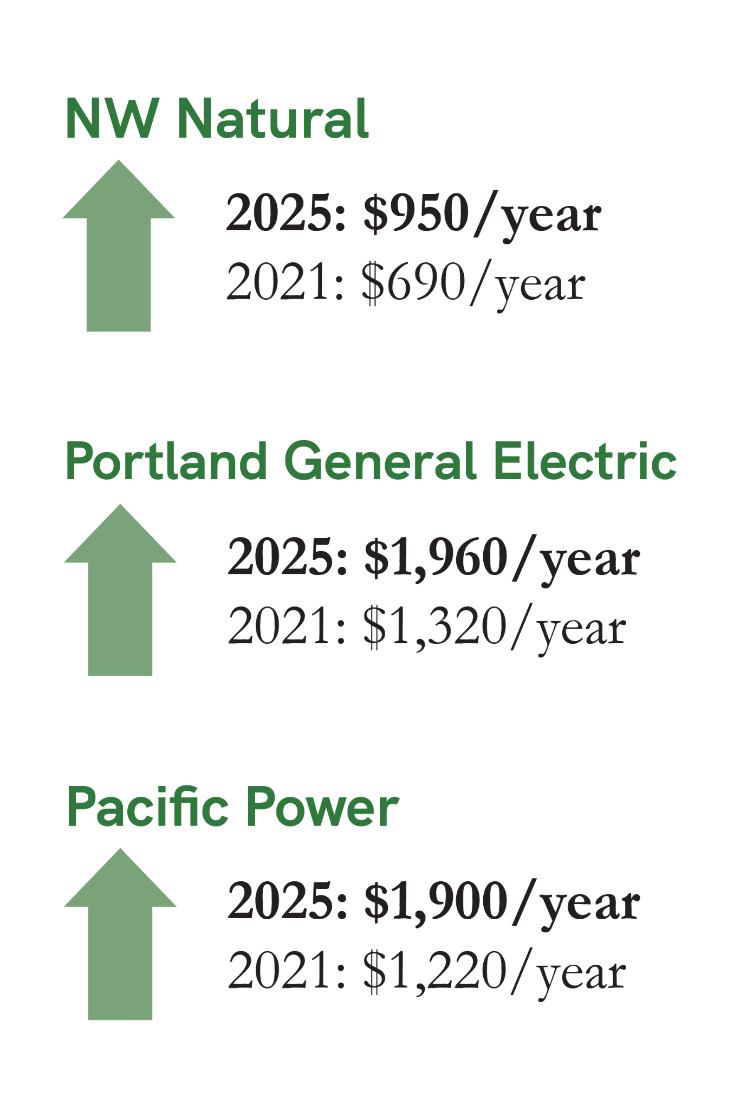
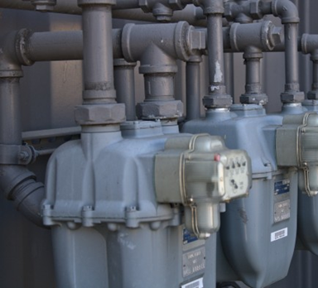
Methane Costs On The Rise
Methane is getting more expensive - and it’s raising all of our energy bills.
In 2022, Oregon’s three major gas utilities increased rates by 18-25% because the wholesale price of natural gas spiked.
Jump in price from 2021 to 2025 is 38%
Having 2 utility bills raises cost
Investing longerm in more methane infrastructure locks us into high costs for decades to come.
Notes:
DavidBB
Why is methane bad for our wallets? Because
Methane is expensive and volatile. Prices range not only from year to year - but season to season.
Gas utilities in Oregon continue to raise their prices due to the variability in methane pricing - in 2022 alone they raised rates between 18-25%.
and if you’re fully electric, don’t think you’re off the hook, Our electric utilities currently rely on gas for power production as well - and as prices rise so do their rates. In 2024, a quarter of PGE’s bill increase was attributed to spikes in methane prices.

Slide 32
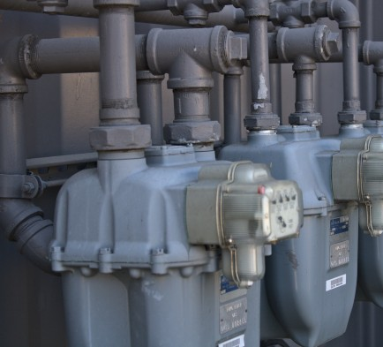
Decades Of Gas Costs On Your Bills
Investing in more methane infrastructure locks us into high costs for decades to come.
New gas pipelines have a 50 year lifespan
Cascade Gas Companies still rely on existing customers to subsidize expanding the gas system by charging you for adding new customers.
Heat pumps are cheaper to run and more efficient
And new gas furnaces last 30+ years!
Notes:
DavidBB
Gas utilities don’t make the majority of their money off of selling gas - but by building out the infrastructure to provide it.
Gas companies will build new infrastructure and raise rates to recoup those investments. But because these costs are spread over many years- customers can get stuck paying for an new pipe or main investment for decades. For context, a pipe installed today will be reflected on a customer bill until 2075.
Further, gas companies rely on existing customers to subsidize system expansions through a mechanism called a Line Extension Allowance. This allows them to raise rates for current customers to build new infrastructure to attract new ones.
Electric heat pumps are shown to be cheaper - and avoid the volatility of the fossil fuel market - BUT gas companies are resistant to fuel switching.

Slide 33
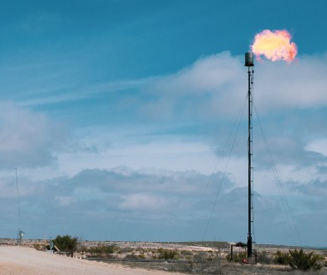
Renewable Natural Gas
To meet climate goals, gas utilities are promoting “climate friendly” alternative fuels — but these aren’t cheap or clean.
NW Natural Gas hasn’t delivered on any renewable gas in Oregon
“Renewable” methane gas is expensive, limited in supply, and not growing fast enough to meet need
Synthetic methane is not commercially ready and would require major investments to scale.
Hydrogen is difficult to produce, costly, and can be unsafe when mixed into existing gas pipelines.
Notes:
Like all other utilities in Oregon, gas companies must reduce their emissions by 50% in 2035 and 90% in 2050. To do this, all three gas utilities in Oregon are asking to invest in so called “climate friendly” alternative fuels - but these are not cheap or clean.
Renewable natural gas, made from methane captured at landfills, farms or wastewater facilities, requires costly infrastructure investments. Even if the gas companies were to buy it - the supply is limited and estimated to grow by only 15-20% by 2030 - not nearly enough to replace the emissions of conventional methane gas.
Synthetic methane is not commercially ready - and again would require very costly production and infrastructure investments to scale.
Hydrogen is difficult to produce, requires costly investments and poses major safety risks (such as pipe degradation) when mixed into existing gas pipelines.
Other alternatives to meet climate goals are already available! Switching to energy efficient electric appliances through targeted electrification, investing in weatherization programs to reduce methane emissions are ways we can reduce our dependence on methane - and its impact on our wallets.

Slide 34
Commonly Heard Fears & Myths
The fears of leaving the gas system (myths & facts)
Myth: Gas systems are cheaper than electric systems.
Fact:
Multiple utility companies mean multiple base rates (the basic charge to be a customer). NW Natural customers pay $13/mo even when not using any gas.
Myth: Gas is more reliable than electric.
Fact:
Efficient electrification technology on the grid reduces power outages and pollution, especially during extreme weather events. It can even slow down bill increases.

Slide 35
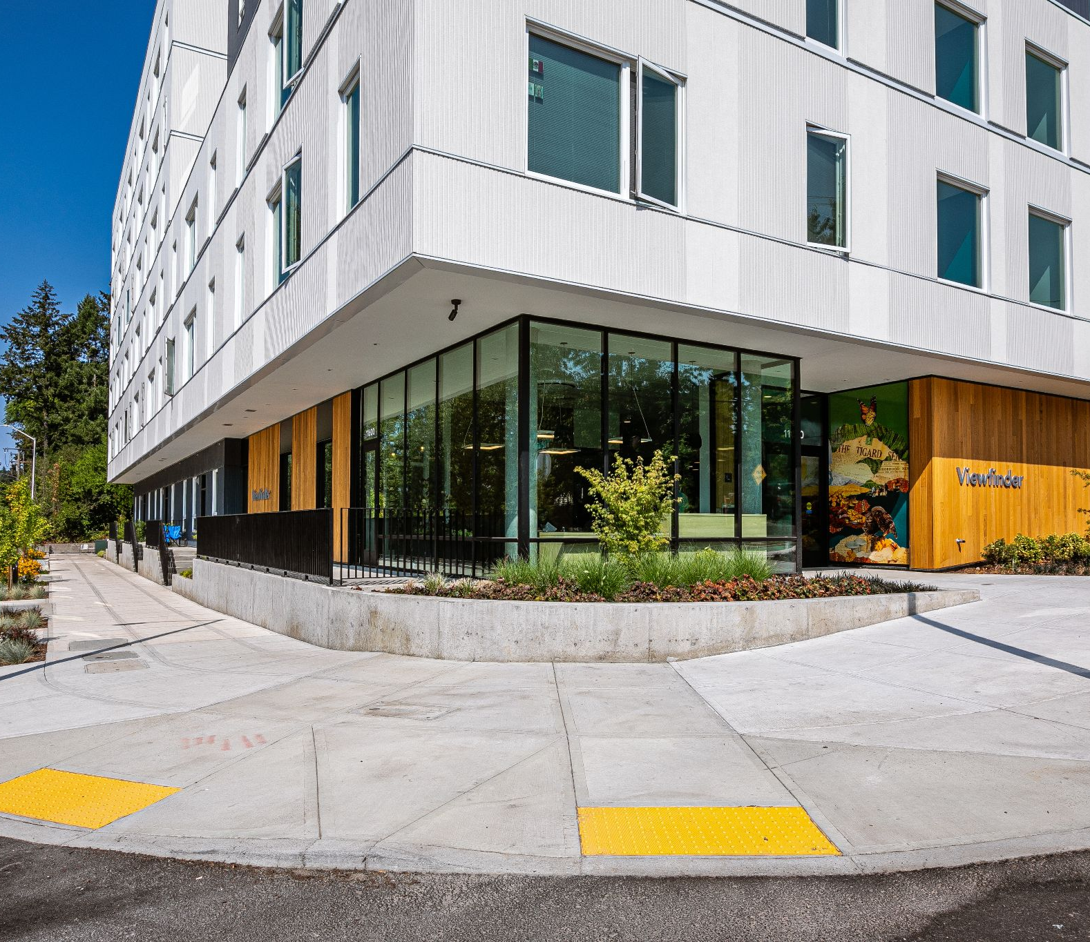
Why Building Resilience?
Homes and buildings are our first line of defense against climate harms like extreme heat and wildfire smoke
Protect public health by improving indoor air quality
Improve affordability by increasing efficiency and reducing energy bill costs.
Cut climate pollution from the second largest source in Oregon.
Create good-paying jobs that can’t be outsourced.
Notes:
Annabelle

Slide 36
Resources:
Natural Gas Bills Increase Due to Soaring Methane Prices
Why Are PGE Bills Increasing in 2024?
NW Natural Massively Overspent on Expanding Its System
Avista Charging Southern Oregon Exorbitant Amounts for Expanding the Gas System
NW Natural Builds New Facility with Tyson Foods
What is Renewable Natural Gas?
How Clean is Renewable Natural Gas?
What's the Deal with Hydrogen?
Potential Dangers of Blending Hydrogen and Natural Gas in Pipelines
NW Natural's Resource Planning Raises Questions at CUB
Bill Discount Programs:
PGE: Call 503-228-6322 or portlandgeneral.com/income-qualified-bill-discount
Pacific Power: Visit PacificPower.net/LID or call 1-888-221-7070
NW Natural: Apply by calling 503-226-4211 or 800-422-4012 Monday-Friday, 7am-6pm or online at www.nwnatural.com/account/bill-discount-program
Avista: Apply online by calling 800-227-9187 or online myavista.com/MyEnergyRate

Slide 37
Methane is Bad for
our Climate and Our Wallets.
Notes:
BVC

Slide 38
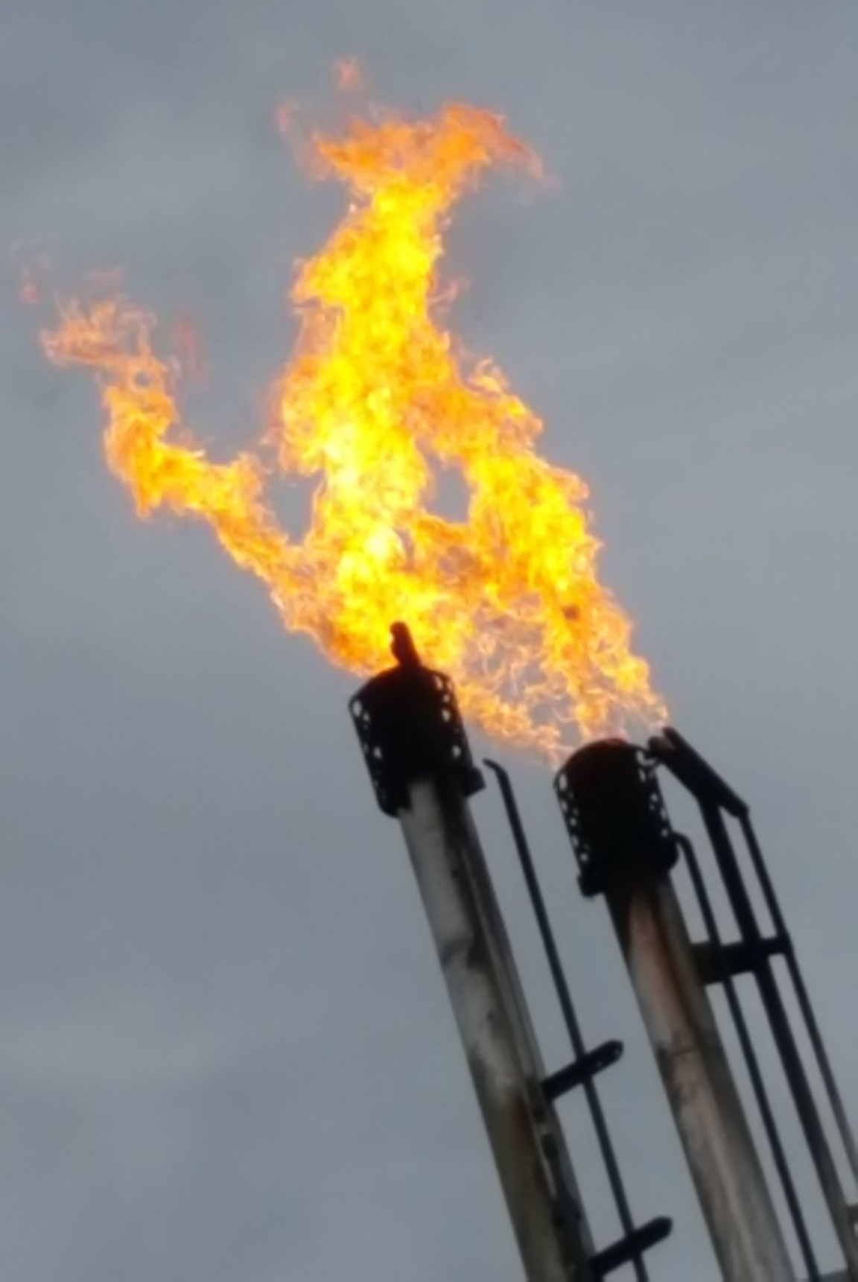
Do you think Methane is better than coal for the CLIMATE?
Perception problem:
Many Oregonians don’t understand why we should reduce gas use.
Many believe it’s a “natural” source of energy and think it is “clean.”
Less than half of Oregonians understand methane is as big a contributor to climate change as coal.
Notes:
Here’s why the the action we’re going to ask you to take tonight is so important. “Warning your neighbors.” So many Oregonians are not up to speed on methane “natural gas” and so education is our most important tool.
In surveys:
Many Oregonians have said they don’t understand why we should reduce gas use.
Many believe it’s a “natural” source of energy and describe it as “clean”.
Less than half of Oregonians understand methane is a major contributor to climate change.

Slide 39

Methane is Bad for the CLIMATE
The Climate Spiral
Notes:
Methane is a potent greenhouse gas, it traps heat much more effectively than CO2 in both the short term 84x more in the first 20 years and 20 x as much as CO2the long term
Where does methane get leaked into the atmosphere? But your answers in the chat.
Major sources of methane are fossil gas production, pipelines, leaks, & appliances in buildings
Methane leaks along the whole system – from the drilling well, to the pipeline, to the way stations and to the burner in our homes.
In Oregon, buildings, agriculture, and dairy farms are one of the largest sources of methane pollution

Slide 40
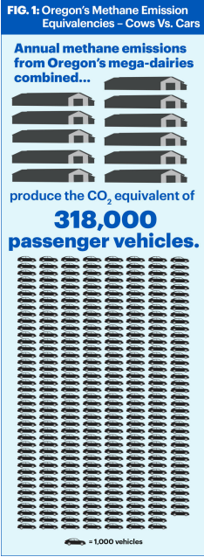
Why Methane is a big Problem
Methane is a potent greenhouse gas, it traps heat much more effectively than CO2
Major sources of methane are fossil gas production, pipelines, leaks, & appliances in buildings
In Oregon, buildings, agriculture, and dairy farms are the largest sources of methane pollution
Methane leaks along the whole system – from the well, to the pipeline to the burner in our homes.
When methane is burned it still makes CO2
Notes:
Methane is 86x more potent than CO2 for warming the planet
Methane leaks from wells and pipelines make “natural” gas as bad for the climate as coal
Nearly one-third of Oregon’s climate pollution comes from homes & buildings, just behind transportation.
Buildings pollute in two ways, burning gas on-site and using electricity created by burning fossil fuels.
The average home with gas furnace and gas water heater create 5 - 11 tons of climate pollution per year.

Slide 41
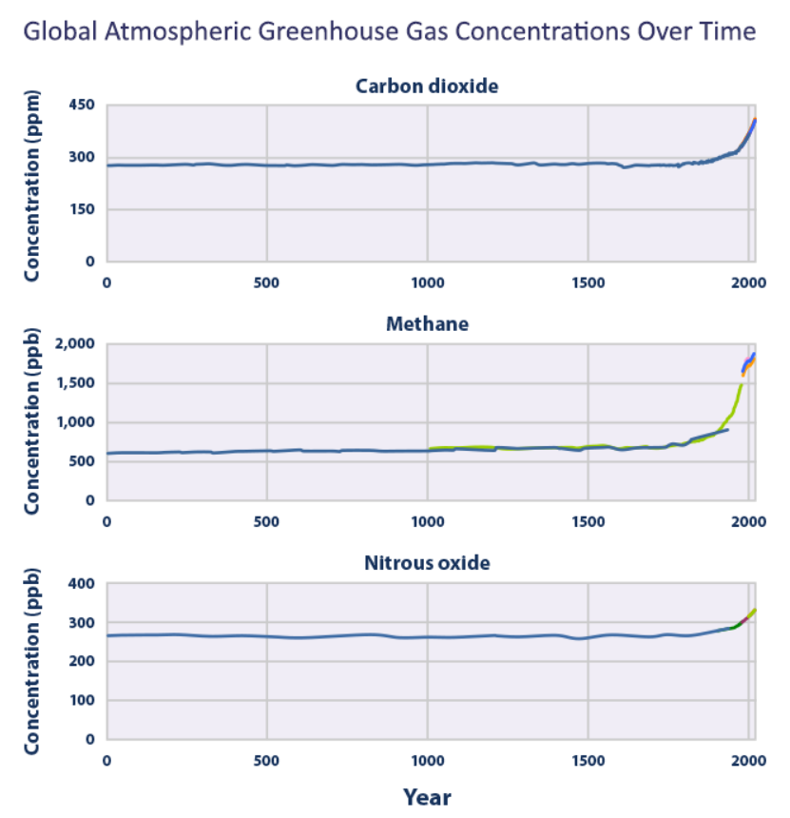
Human Caused Climate Change
Although the Earth goes through periods of warming and cooling, human activity has increased the warming we’ve been seeing since the 1950s.
Burning fossil fuels is one of the largest contributors to climate change, which causes an increase in the concentration of Greenhouse Gases in the atmosphere. Methane contributes faster than other GHGs.
Notes:
https://science.nasa.gov/climate-change/causes/
https://www.epa.gov/climatechange-science/causes-climate-change

Slide 42
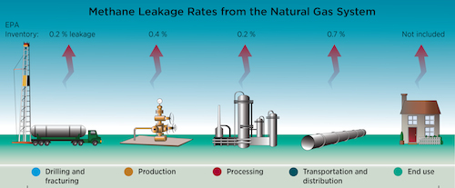
Methane Leaks: 3% of Production
Credit: Stanford University/Science-2014
Notes:
Where does all this methane leakage occur? Methane is a gas so easily “leaks” into the atmosphere.These numbers were calculated by the EPA, but measured figures show leakage rates of 3% or more. In fact a new study suggests that end use methane leakage is nearly 1%.
Release at the time of initial drill if it goes through pockets of methane.
Backflow from fracking fluids coming back to the surface without capturing the gaseous contents including the natural gas.
Leaks around the cement casing placed to avoid leakage of product into the water table. (6x the cement casing failure from fracked wells).
However, it is felt that leakage rates rise over time from wells esp abandoned wells.
Leakage can also occur during storing and processing with use of the unprocessed natural gas to run the generators and venting done to maintain pressure in the pipelines.
Leakage from high-pressure pipelines to delivery locations.
Increased natural gas in home heating and cooking through seriously aging pipelines has been well-documented to be leaking serious amounts in D.C. and Boston.
Science 14 February 2014:
Vol. 343 no. 6172 pp. 733-735
DOI: 10.1126/science.1247045 source of image. Refuted in amounts

Slide 43
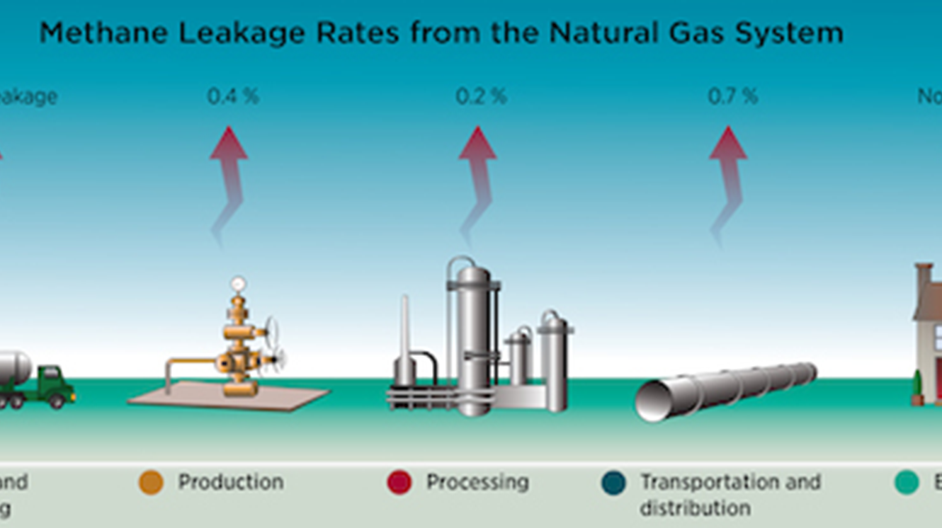
How Do We Eliminate Leaks?
Cap abandoned wells
Find and fix leaks
Reduce methane use:
  Building efficiency
  Electrify everything
  Don’t replace with biogas
Notes:
Background: 130,000 abandoned wells (2022) but EPA estimates as high as 2-3 million. 9 million live within 1 mile of a well.
Biden released $1.15 Bil to help cap them (another 3.55 bil left in funding)
No change in requirement for corporations to hold adequate reserves to cap wells should they go bankrupt.
Biggest bang is to reduce drilling and using methane!

Slide 44
Real Solutions: Electrification & Grid Resilience
Electrification:
Shift homes & buildings from gas to electric pumps, water heaters, induction stoves
Grid Resilience:
Invest in a stronger, smarter electric grid that handle heat waves & storms
Increase energy efficiency, rooftop solar, batteries, and microgrids
Together, electrification + grid resilience cut methane pollution and make communities safer during climate extremes.

Slide 45
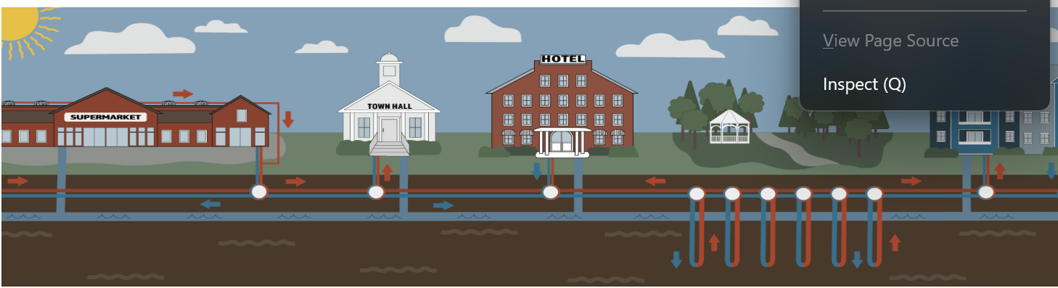
Building Better from the Start
Building codes for efficiency-lowers heating/cooling costs
Build with no gas
Ban Gas in buildings
Build non-pipeline heating alternatives, such as targeted ground-sourced heat pumps or Thermal Energy Networks

Slide 46
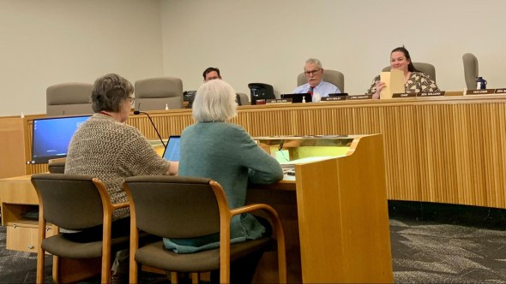
Get Involved
So what can be done?
Talk with your neighbors!
Clean up your home!
Join an Organization: Sierra Club, Oregon or Washington PSR, League of Women Voters
Cut the beef!
www.OregonPSR.org
https://www.wpsr.org/
League of Women Voters: www.LWVOR.org
Notes:
DavidBB

Slide 47
Questions?

Slide 48

Join the Building Resilience Email List in Oregon

